Slide 1

Soccer Guru: a football match prediction pipeline
Fernando Miñaur
Marco Ramos
Miguel Calvo
Julio Lezama (missing in action)

Slide 2

Motivation & Business Problem
Create a platform that is:
Free
Transparent
Accessible
Well documented
Open source (Github)
So that passionate people of this sport could bet on the results of football matches.
The problem that we wanted to solve throughout the project was to predict the result of soccer matches with accurate information using historical data of past confrontations.

Slide 3


Machine Learning
Historical data in the database can be used as an historical developement of a football team overall.
Supervised Machine Learning: known target variable (Winning team id)

Slide 4
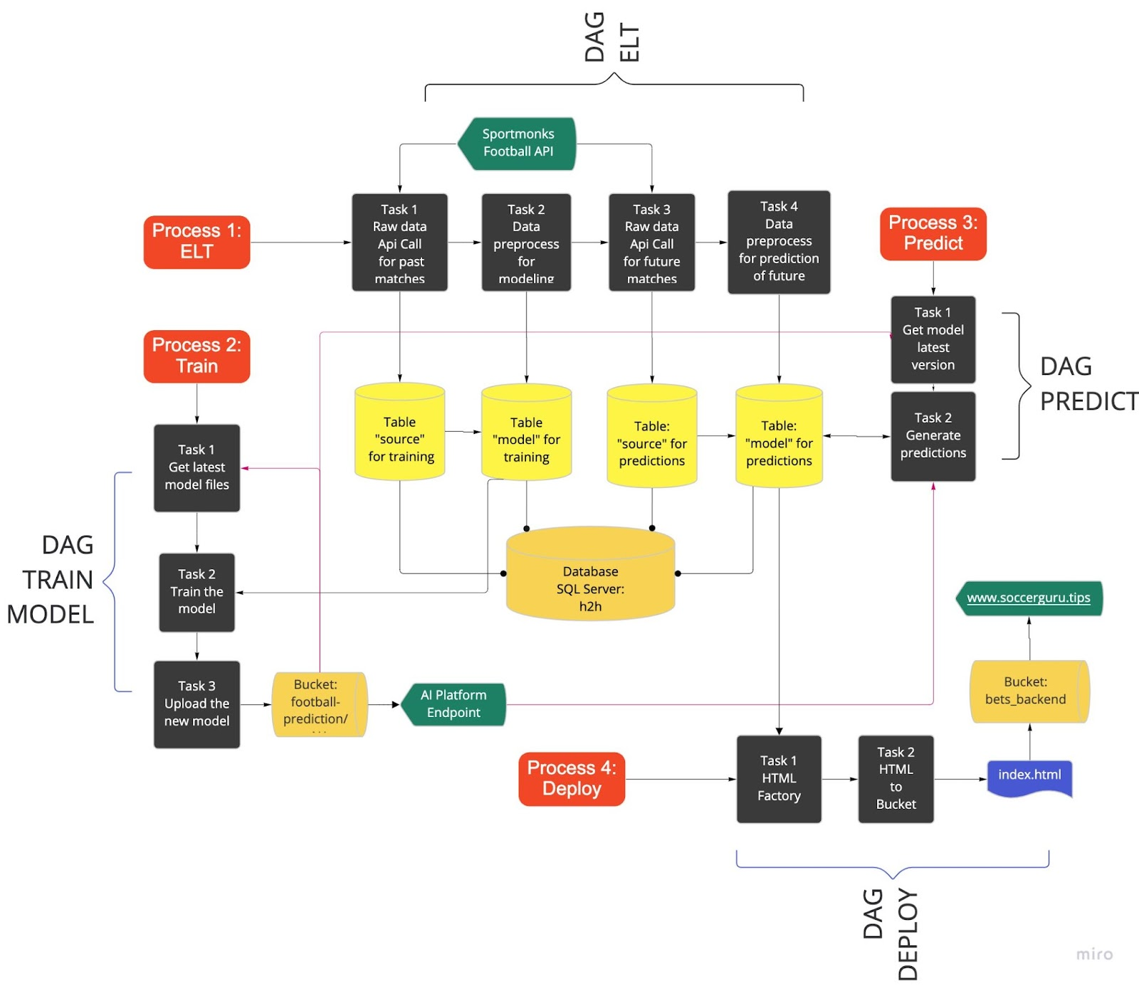
System Design

Slide 5





Data Ingestion

Slide 6
Selected features
league_id
Id of the league f.e. Copa del Rey
Categorical
season_id
Id of the season f.e. 2022
venue_id
Id of the venue f.e. Santiago Bernabéu
referee_id
Id of the referee
Features
localteam_id
Id of the local team
visitorteam_id
Id of the visitor team
Numerical
localteam_position
Current position of the local team in the table
visitorteam_position
Current position of the visitor team in the table

Slide 7
Feature Engineering
Four new variables:
Weighted goals scored by local team
Weighted goals scored by visitor team
Current winning streak local team
Current winning streak visitor team

Slide 8

Model Development and Evaluation

Slide 9
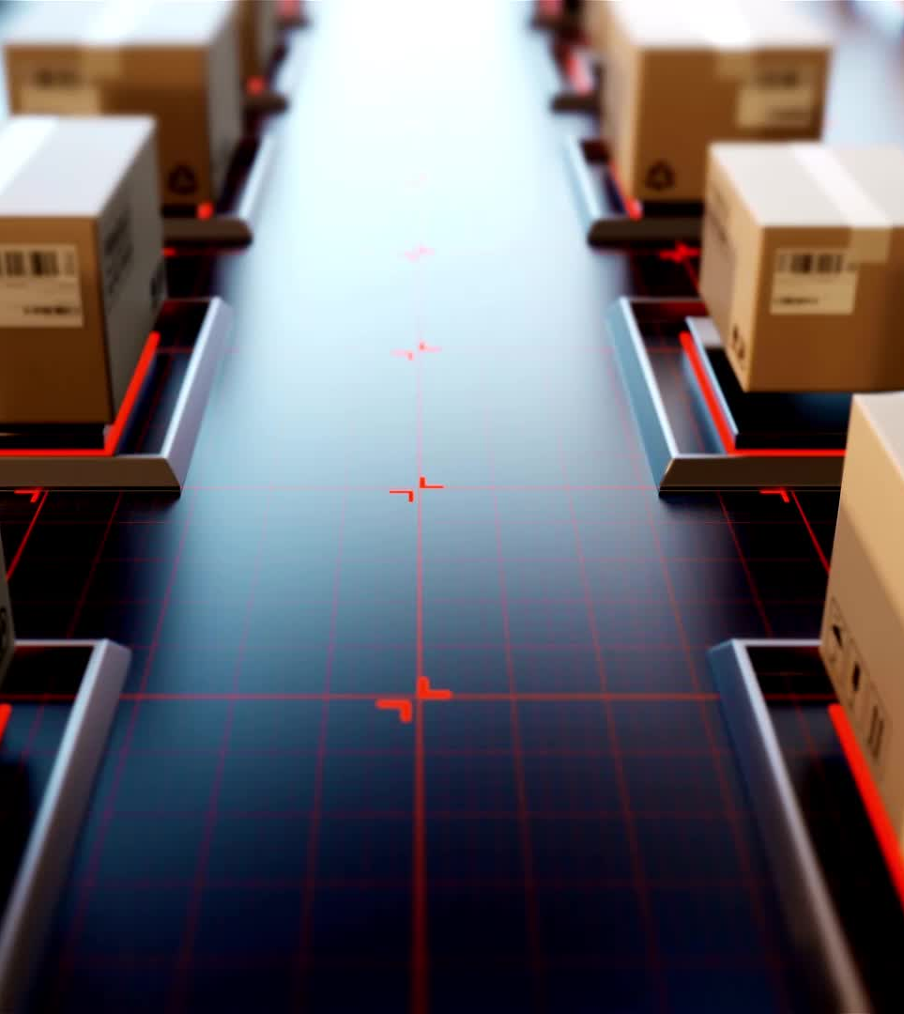
First experiments
Logistic Regression
L1 Logistic Regression
Random Forest
Train Accuracy | Test Accuracy
63.58% | 61.28%
Train Accuracy | Test Accuracy
62.14% | 61.14%
Train Accuracy | Test Accuracy
65.71% | 66.2%

Slide 10
Best model XGBoost
Train Accuracy | Test Accuracy
77.34% | 74.29%

Slide 11

Best Local Model: Random Forest with feature engineering
Train Accuracy | Test Accuracy
84.83% | 85.65%

Slide 12
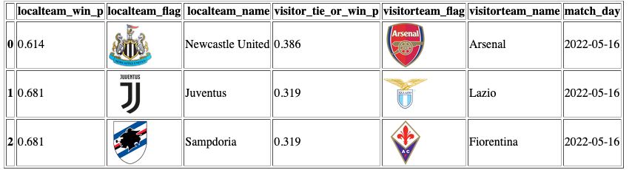
Final product
We developed a webpage since the product is meant to be for a final user rather than a machine.
The webpage can be found in: https://www.soccerguru.tips/index.html and it will show the next games with its respective probabilities.

Slide 13
References:
-Sze Yeung. Football Prediction by XGBoost. Kaggle https://www.kaggle.com/code/szeyeung/football-prediction-by-xgboost/notebook?scriptVersionId=94437712
-Utikal, N. (26 December 2019). Predicting Football Results with Random Forest. Obtenido de Medium: https://medium.com/@nicholasutikal/predict-football-results-with-random-forest-c3e6f6e2ee58
-Calvo, M., Miñaur, F., Ramos, M., & Lezama, J. (3 de February de 2022). Github. Obtenido de Ubiquitous-Goggles: https://github.com/JulioLezamaAmastalli/ubiquitous-goggles/
-Densmore, J. (10 February 2021). Data Pipelines Pocket Reference: Moving and Processing Data for Analytics
-SportsMonk. From SportsMonk: https://docs.sportmonks.com/football/

